Slide 1


Title of the Project
Review-I
AY 2025-26
Capstone Project – Introduction (PROJ2999)
GITAM (Deemed-to-be) University
Department of Electrical Electronics and Communication Engineering
Project Team:
C. Lakshmi Narayana
P. Hemanth
P. Hari Krishna
Project Mentor:
Dr. T. Nagarjuna
Project In-charge:
Dr. Kshitij Shakya
www.gitam.edu

Slide 2
Objective and Goals
Objective
The primary objective is to design and implement a comprehensive, end-to-end simulator for the 5G NR physical layer. This software tool will serve to evaluate system performance under various channel conditions and validate the efficacy of signal processing algorithms before hardware implementation.
Goals
To implement core 5G technologies like LDPC coding, QAM modulation, and OFDM
To build a complete end-to-end 5G physical layer simulator in MATLAB from the ground up.
To analyze and visualize key performance metrics such as Bit Error Rate (BER) and throughput.
To validate the simulator's accuracy by comparing its output with official 3GPP performance benchmarks.

Slide 3
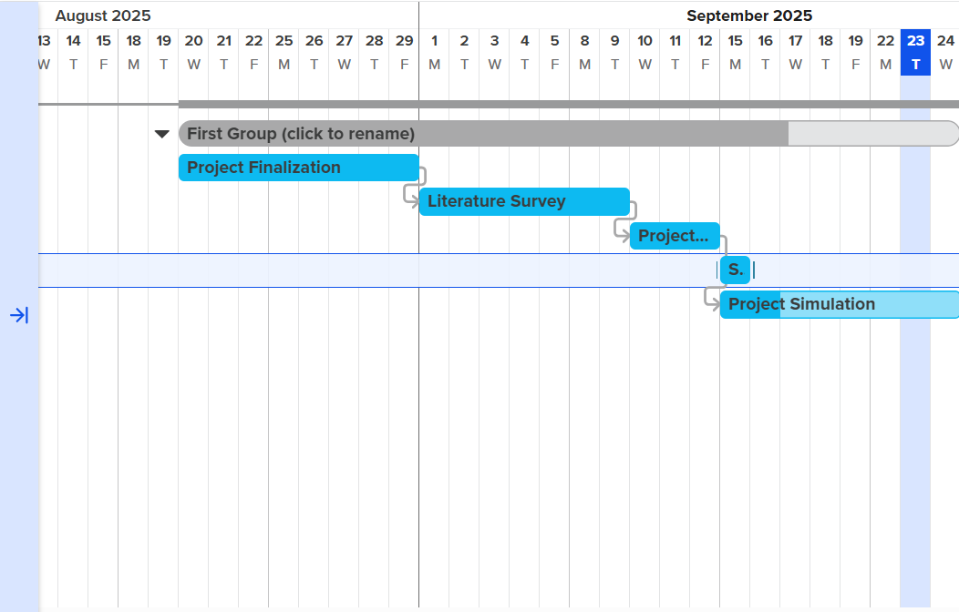
Project Plan (Clearly mention milestone for objectives under each reviews)
Gant Chart - Milestones and Activities

Slide 4
Project Plan (Clearly mention milestone for objectives under each reviews)
Gant Chart – Milestones and Achievements

Slide 5
Literature Survey
Research Paper: S. Lagen, K. Wanuga, H. Elkotby, S. Goyal, N. Patriciello and L. Giupponi, "New Radio Physical Layer Abstraction for System-Level Simulations of 5G Networks," ICC 2020 - 2020 IEEE International Conference on Communications (ICC), Dublin, Ireland, 2020, pp. 1-7, doi: 10.1109/ICC40277.2020.9149444.
Key Publications :
Category | Summary
Main Aim of the Paper | The primary goal is to develop and implement a Physical Layer (PHY) abstraction model for 5G New Radio (NR). This abstraction estimates PHY performance in System-Level Simulators (SLSs) to significantly speed up simulations by eliminating computationally intensive PHY processing. The model capitalizes on the Exponential Effective Signal-to-Interference-plus-Noise Ratio (SINR) Mapping (EESM) method. It was integrated into the open-source ns-3 based NR system-level simulator
Key Achievements & Methodology | An NR-compliant Link-Level Simulator (LLS) was used to calibrate the EESM method and derive optimal $\beta$ values for various Modulation and Coding Schemes (MCSs). The resulting L2SM (Link-to-System Mapping) was demonstrated to be insensitive to the NR numerology (e.g., subcarrier spacing/SCS), validating the model's application across all NR frequency ranges

Slide 6
Key Achievements & Methodology | End-to-end ns-3 simulations confirmed that adaptive MCS approaches combined with HARQ resulted in 0% application layer packet loss up to 70m distance, significantly outperforming fixed MCS strategies
Flaws and Limitations Identified | The model assumes simplifications for Hybrid Automatic Repeat reQuest (HARQ) retransmissions, specifically that the same MCS and number of Resource Blocks (RBs) are used across transmissions. To speed up LLS runs, the SINR-BLER lookup tables were generated without code block segmentation; this process is instead integrated entirely into the abstraction model
Key Resources – Whitepaper| Application Notes | Datasheet| Others
https://devopedia.org/5g-nr-phy
Existing Implementations – Products| Opensource| GitHub etc
GitHub : https://github.com/kir812/pyPhyNR

Slide 7
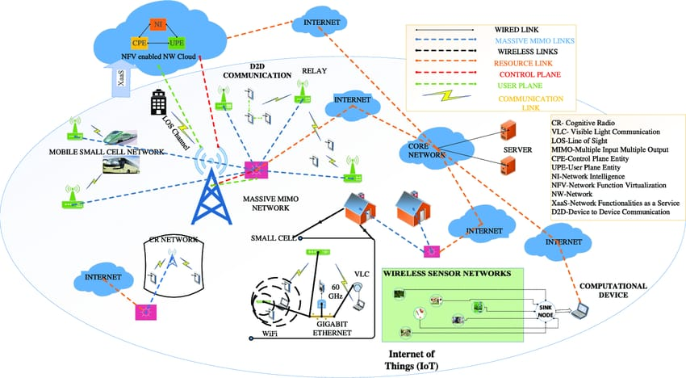
Architecture

Slide 8
THANK YOU
Have a Great Day !

